Slide 1
NAAN MUDHALVAN
TOPIC : AN ANDROID APPLICATION FOR LATEST HEADLINES
SUBMITTED BY
DHARUN.V (812022205011)
DHINESHKUMAR.R (812022205012)
KARTHIK.A (812022205022)
PIRUTHIVI RAJA. S(812022205034)

Slide 2
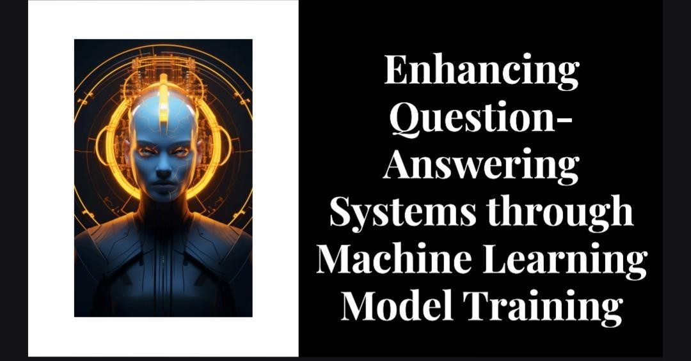

Slide 3
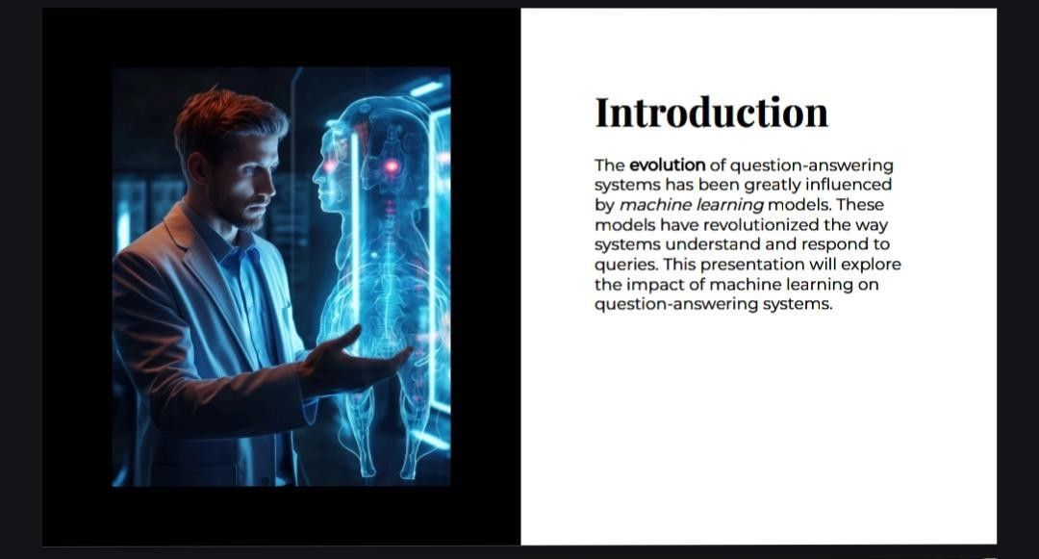

Slide 4
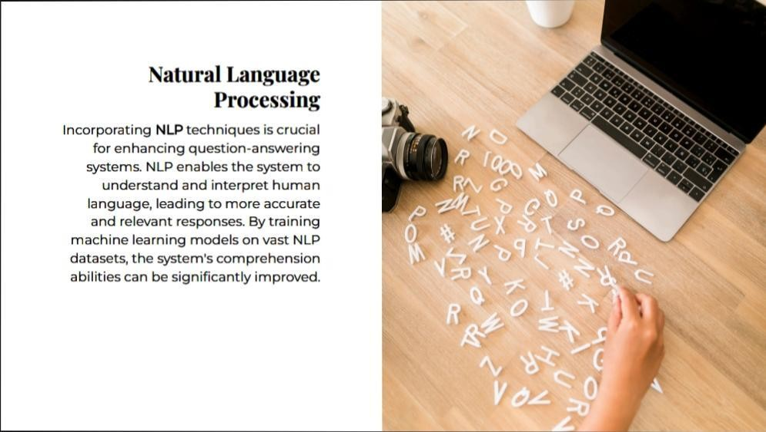

Slide 5
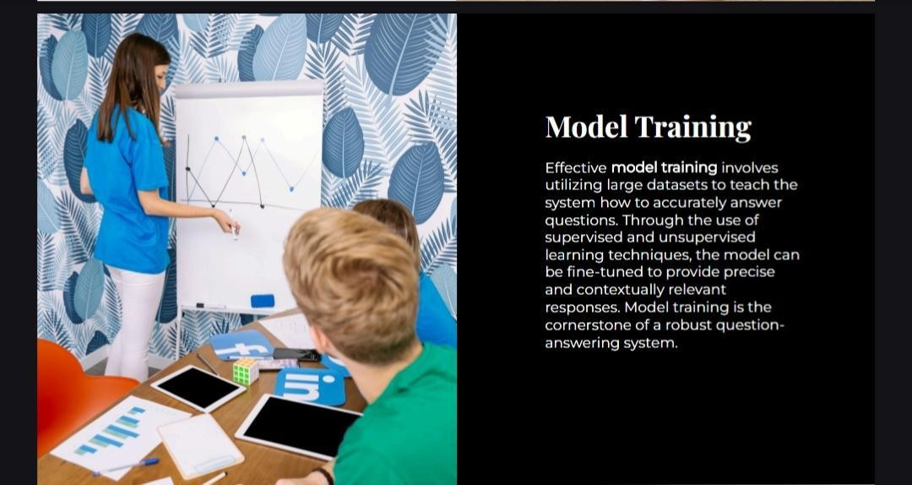
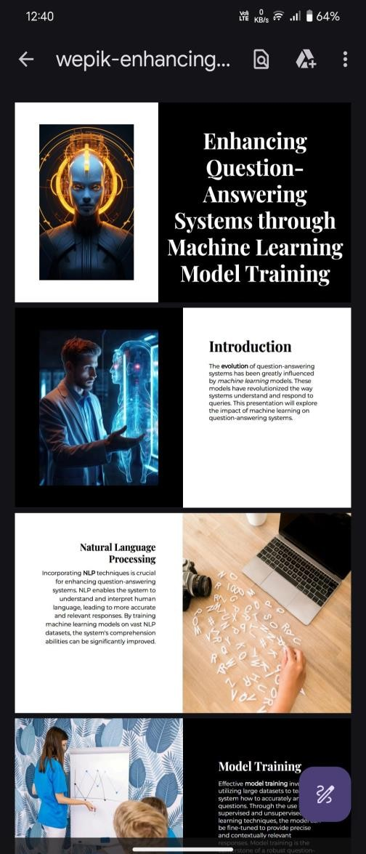

Slide 6
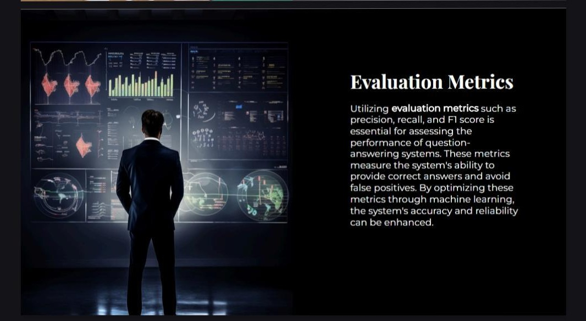

Slide 7
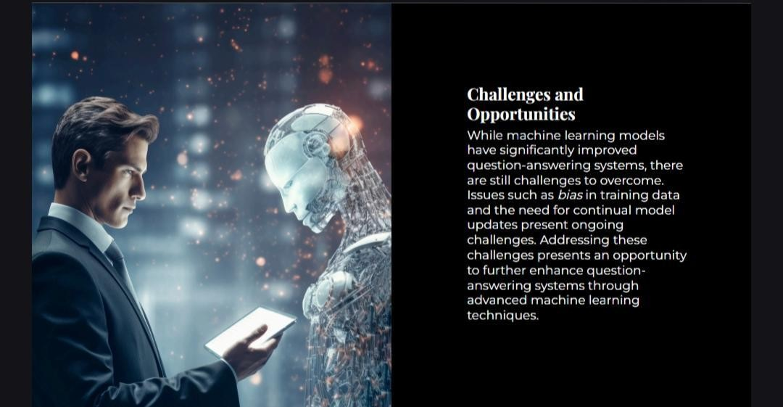

Slide 8
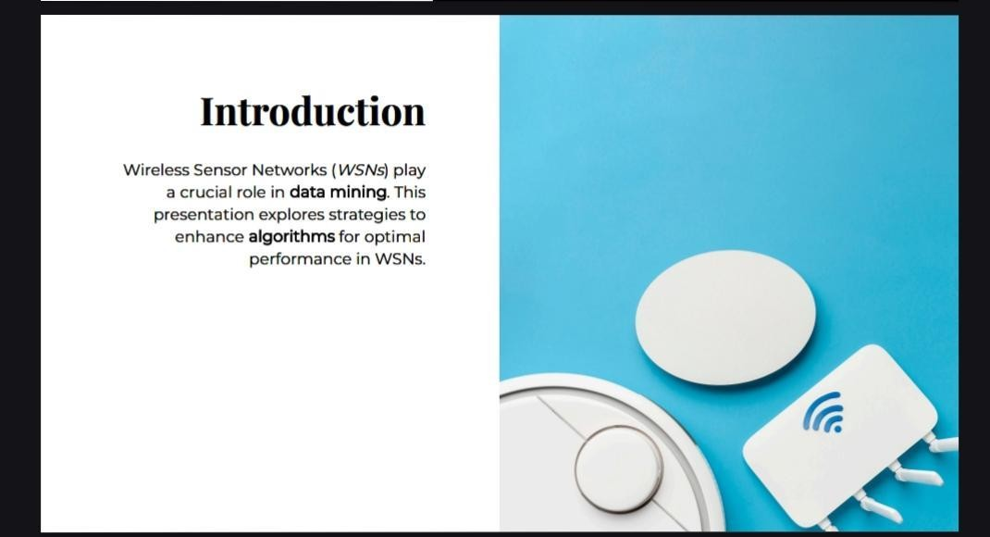

Slide 9


Slide 10
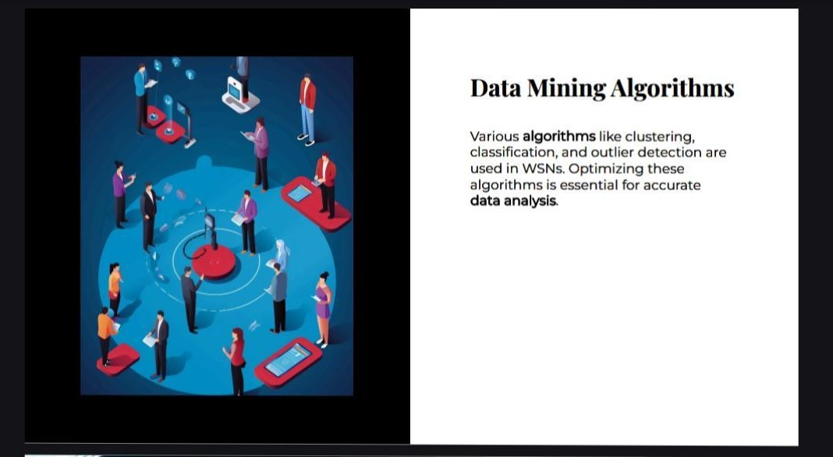

Slide 11


Slide 12
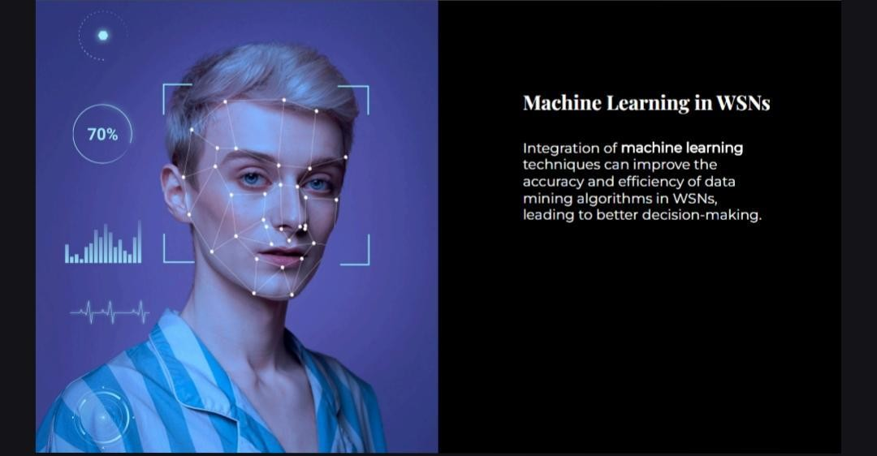

Slide 13


Slide 14
▶THANK YOU

